Slide 1

Employees Data Analysis Using Excel

Slide 2
Details of myself
Presented by -Ratchaga.R
Register no -620E5BE24BD385DB2404BF92909B89F3
Department -Department of commerce Honours
College - Sri Kanyaka Parameshwari arts and science college for women

Slide 3

PROJECT TITLE EMPLOYEE PERFOMANCE ANALYSIS USING EXCEL

Slide 4
AGENTA
1.Problem statement
2.Project overview
3.End users
4.Our solution and proposition
5.Dataset description
6.Modeling approach
7.Results and discussion
8.conclusion

Slide 5
Problem statement
Despite having established performance standards and goals, our organization is experiencing variability in employee performance across different departments.
This inconsistency is leading to suboptimal productivity, employee dissatisfaction, and missed business objectives.
The current performance management system does not adequately address the factors contributing to these performance discrepancies, and there is a lack of clarity on how to effectively support employees in achieving their potential.

Slide 6

Project overview
To develop and implement a comprehensive performance management strategy that:Standardizes performance evaluation criteria and feedback processes
Aligns individual goals with organizational objectives
Provides targeted support and development opportunities for employees.Enhances overall productivity and employee satisfaction.

Slide 7
End users
Human Resources (HR) Professionals: Oversee the implementation and administration of performance management systems.
Senior Leadership: Utilize performance data to make strategic decisions.
Training and Development Teams: Use performance data to identify skills gaps
Executives and Decision Makers: Rely on performance insights to drive organizational strategy,

Slide 8
Our solution and proposition
Enhanced Performance Evaluation System
Objective: Standardize and streamline performance evaluations to ensure consistency and fairness
Key Features:Clear performance metrics and criteria aligned with organizational goals.
Goal Alignment and Management
Objective: Ensure that individual goals are directly linked to organizational objectives
Key Features:SMART (Specific, Measurable, Achievable, Relevant, Time-bound) goal setting framework.
Objective: To enhance overall employee performance through a comprehensive, integrated performance management system that aligns individual goals with organizational objectives, supports ongoing development, and fosters a culture of continuous improvement.

Slide 9

Dataset description
Employee InformationEmployee ID: Unique identifier for each
Employee.Name: Full name of the employee
Department: The department or team to which the employee belongs
Position/Role: Job title or role of the employee
Employment Date: Date when the employee joined the organization
Manager/Supervisor: Name or ID of the employee’s direct supervisor.

Slide 10
Modeling Approach
Define Objectives and Metrics
Objective: Identify what you aim to achieve with the model (e.g., predicting high performers, identifying skill gaps, assessing the impact of training)
Metrics: Determine key performance indicators (KPIs) and success metrics (e.g., productivity, quality scores, employee satisfaction).
Choose Modeling TechniquesDescriptive Analytics: Use techniques such as exploratory data analysis (EDA) to understand patterns and trends in performance data
Tools: Histograms, correlation matrices, and summary statistics.Predictive Modeling: Develop models to forecast future performance or identify potential issues.

Slide 11
Results and discussion
1.Results
Descriptive Statistics
Predictive Modeling
Clustering Analysis
Recommendation System
2.Discussion
Insights into Performance Trends
Implications of Predictive Modeling
Clustering Results and Targeted Interventions
Effectiveness of Recommendation Systems
Ethical Considerations and Model Fairness
Future Directions
Limitations

Slide 12
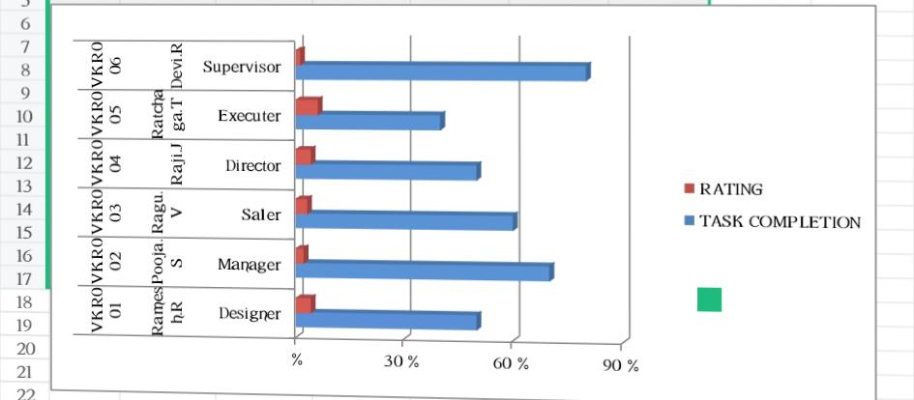
Results

Slide 13
Conclusion
The comprehensive analysis of employee performance through advanced modeling techniques has provided valuable insights into how various factors influence performance outcomes and how to enhance overall effectiveness within the organization. Key findings highlight the positive impact of targeted training, the utility of predictive models in identifying high and low performers, and the effectiveness of personalized development plans.

Slide 14
Thank You

